Slide 1





Vikrant Vikaasa.V
NM id: au711721243125
Final Project
1

Slide 2

PROJECT TITLE
Building a Chatbot Using Keras
2

Slide 3



AGENDA
PROBLEM STATEMENT
PROJECT OVERVIEW
WHO ARE THE END USERS?
YOUR SOLUTION AND ITS VALUE PROPOSITION
THE WOW IN YOUR SOLUTION
MODELLING
RESULTS
3

Slide 4

PROBLEM STATEMENT
Develop an intelligent chatbot system capable of understanding user intents and providing appropriate responses using natural language processing (NLP) techniques and deep learning. The goal is to create a conversational agent that can effectively classify user input into different intents and generate relevant responses, enhancing the overall user experience in interactive systems.
4

Slide 5

PROJECT OVERVIEW
This project focuses on creating a chatbot using the Keras deep learning framework.
The chatbot will be trained to understand user intents from text inputs and generate relevant responses.
It involves preprocessing a dataset, designing a neural network architecture with Keras layers like Embedding and Dense, training the model to recognize intents, and deploying the chatbot for interactive use cases.
The goal is to develop a functional and responsive conversational agent using Keras for natural language understanding and generation.
5

Slide 6
WHO ARE THE END USERS?
Customers: In customer service applications, end users are the customers who interact with the chatbot to seek information, assistance, or support. The chatbot can handle common queries, provide product information, troubleshoot issues, and offer basic services.
Website Visitors: If the chatbot is integrated into a website, the end users are the visitors to the website. They can use the chatbot to ask questions, navigate the site, request help, or engage in interactive experiences.
Mobile App Users: For chatbots deployed within mobile applications, the end users are the app users. They can access the chatbot's functionalities through the app interface, such as asking questions, receiving recommendations, or accessing personalized services.
Employees: In internal business applications, employees can be end users of chatbots designed for tasks such as HR inquiries, IT support, knowledge base access, scheduling, or workflow automation within the organization.
Students or Learners: In educational contexts, students or learners can be the end users of chatbots designed to provide learning support, answer questions related to course materials, offer study tips, or facilitate interactive learning experiences.
General Public: In public-facing chatbot applications, such as information portals, news platforms, or entertainment services, the end users can be the general public seeking information, updates, recommendations, or entertainment through the chatbot interface.
6

Slide 7
YOUR SOLUTION AND ITS VALUE PROPOSITION
Solution:
Define Objectives: Clarify the chatbot's purpose and target audience to align its functionalities and features effectively.
Select Technology Stack: Choose suitable tools and frameworks like Keras for efficient development and integration of natural language processing capabilities.
Data Preprocessing: Ensure data quality through normalization and tokenization, optimizing inputs for training and improving model accuracy.
Model Training: Train the chatbot using deep learning techniques, adjusting parameters to enhance language understanding and response generation.
Integration and Testing: Integrate the trained model into the deployment platform, conduct thorough testing, and refine the chatbot based on user feedback for optimal performance.
7

Slide 8
YOUR SOLUTION AND ITS VALUE PROPOSITION
Value Proposition:
Cost Efficiency: Building a chatbot using Keras and deep learning technologies can lead to cost savings by automating tasks that would otherwise require human intervention. This can include customer support, data entry, information retrieval, and more.
Improved Operational Efficiency: The chatbot streamlines processes and workflows by handling routine interactions, freeing up human resources to focus on more complex or strategic tasks. This improves overall operational efficiency within an organization.
Data Insights and Analytics: The chatbot can generate valuable insights from user interactions, such as frequently asked questions, user preferences, common issues, and user sentiment analysis. These insights can inform decision-making, product/service improvements, and marketing strategies.
Enhanced Customer Service: A well-designed chatbot can provide 24/7 support, consistent responses, and personalized recommendations, leading to enhanced customer satisfaction and loyalty. This strengthens the brand image and fosters positive customer relationships.
Competitive Advantage: Embracing AI-driven solutions like chatbots demonstrates technological innovation and responsiveness to customer needs. It can differentiate a business in the market, attract new customers, and retain existing ones by delivering superior user experiences.
7

Slide 9
THE WOW IN YOUR SOLUTION
Advanced NLP Techniques: Utilize cutting-edge natural language processing techniques, powered by Keras, for accurate language understanding and context-aware responses.
Seamless Integration: Integrate the chatbot seamlessly into existing platforms and systems, enhancing user experience and workflow efficiency.
Personalized Interactions: Implement personalized interactions through machine learning, creating a tailored experience for each user.
Continuous Learning: Enable the chatbot to learn and improve over time through feedback loops and adaptive algorithms.
Scalability and Performance: Design a scalable architecture that ensures high performance even under increased user load, ensuring a smooth and responsive chatbot experience.
8

Slide 10
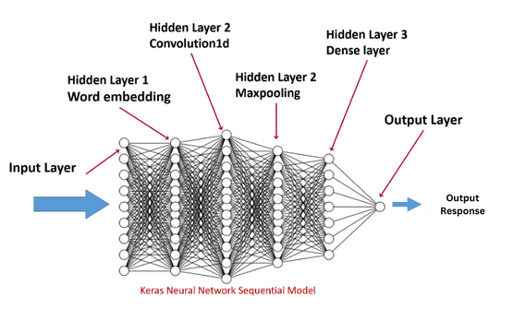
MODELLING
The model, built using Keras, operates by first tokenizing and encoding input text data to numerical sequences. These sequences are then fed into an embedding layer that transforms words into dense vectors, capturing semantic relationships. The subsequent layers, such as LSTM or Dense layers, process these embeddings to extract patterns and learn the underlying structure of the text data. During training, the model adjusts its parameters through backpropagation to minimize the loss function, optimizing its ability to classify intents or generate responses accurately. Regularization techniques like dropout are employed to prevent overfitting and enhance generalization. After training, the model can classify new input text by predicting the most probable intent or generating contextually appropriate responses based on learned patterns, providing a seamless and intelligent conversational experience in the chatbot system.
9

Slide 11
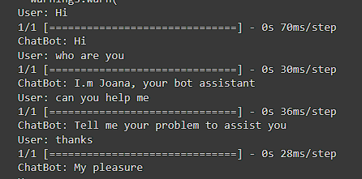
RESULTS
10

